Slide 1
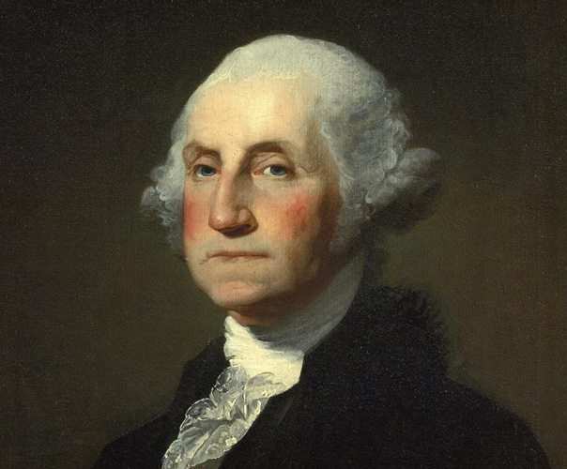
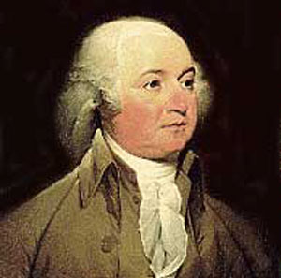
Washington and Adams
Presidencies

Slide 2
Standard: SSUSH5e. Explain the importance of the Presidencies of George Washington and John Adams; include the Whiskey Rebellion, non-intervention in Europe, and the development of political parties
Objective: Student will explain the importance of the presidencies of George Washington and John Adams

Slide 3
WARM UP “We are in a wilderness without a single footstep to guide us” - James Madison What do you think Madison meant?

Slide 4
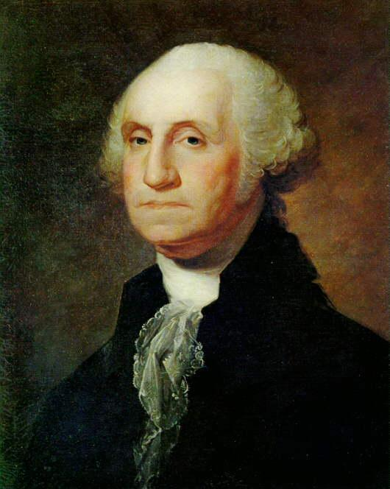
Washington’s Presidency

Slide 5
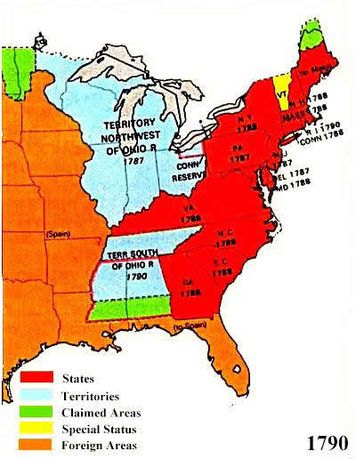

Slide 6
How would America be governed?
The Constitution was the foundation
Washington made practical decisions about how to run the country

Slide 7
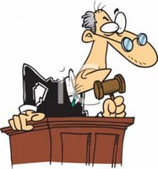
Judicial Act of 1789
Created judicial system
Established federal law as the “supreme Law of the Land”

Slide 8
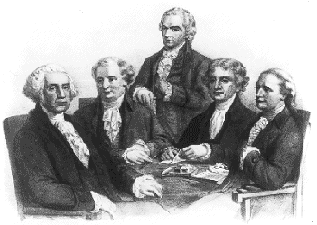
Executive Branch
President and his Cabinet
When Washington was elected the Executive Branch was made up of the president and vice-president
Congress created the departments to help govern

Slide 9
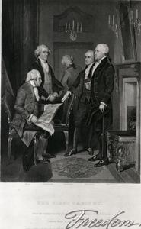
Washington’s Cabinet
Secretary of State = Thomas Jefferson
Secretary of Treasury = Alexander Hamilton
Secretary of War = Henry Knox
Attorney General = Edmund Randolph

Slide 10
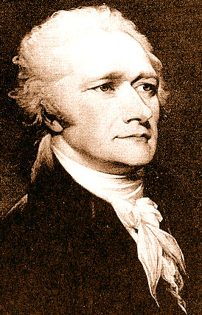
Bank of the United States
Alexander Hamilton
National Bank
Issue paper money, handle tax receipts, and other government funds
To win Southern support, Hamilton proposed moving the capital to Washington, D.C.

Slide 11
Hamilton and the Federalists
Strong National Government
Power concentrated in Federal government
Loose interpretation of the Constitution (National Bank constitutional)
Federalists: George Washington, Alexander Hamilton, John Adams

Slide 12
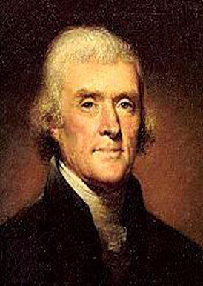
Jefferson and the Democratic-Republicans
Strong State governments
Limited national government
Strict Interpretation of the Constitution (National bank unconstitutional)
Thomas Jefferson, James Madison

Slide 13
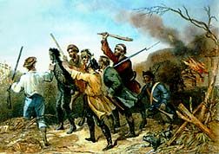
The Whiskey Rebellion

Slide 14
Whiskey Rebellion
To raise money, Alexander Hamilton pushed for an excise tax on whiskey
Excise Tax: tax on a product’s manufacture, sale, or distribution
Most whiskey makers were small frontier farmers, and Hamilton knew this would make them furious.

Slide 15
Whiskey Rebellion
1794 - Farmers in western Pennsylvania refused to pay the tax, beat up federal marshals and threatened to secede from the Union.
Whiskey makers tar and feather tax collector

Slide 16
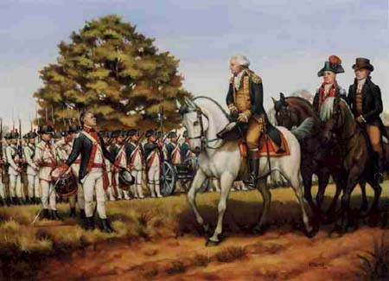
Whiskey Rebellion
Alexander Hamilton and President Washington sent a militia to put down the rebellion.
Whiskey Rebellion sent an important message about the power of the federal government.

Slide 17
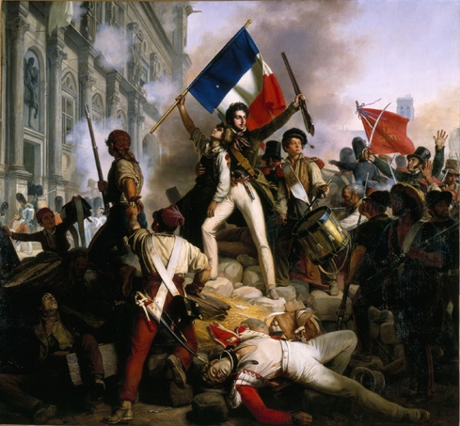
U.S. Response to Events in Europe
French Revolution - Should America get involved?
After the death of the king of France, revolutionaries were at war with other European nations, including Great Britain
In 1793, Washington issues a declaration of neutrality to keep the U.S. out of wars between other nations.
This would help American relations with Great Britain, but France and French supporters in the U.S. were upset.

Slide 18
Pinckney’s Treaty of 1795
U.S. gets all the land east of the Mississippi River from Spain
Spain agrees to allow Americans to use the Mississippi River

Slide 19
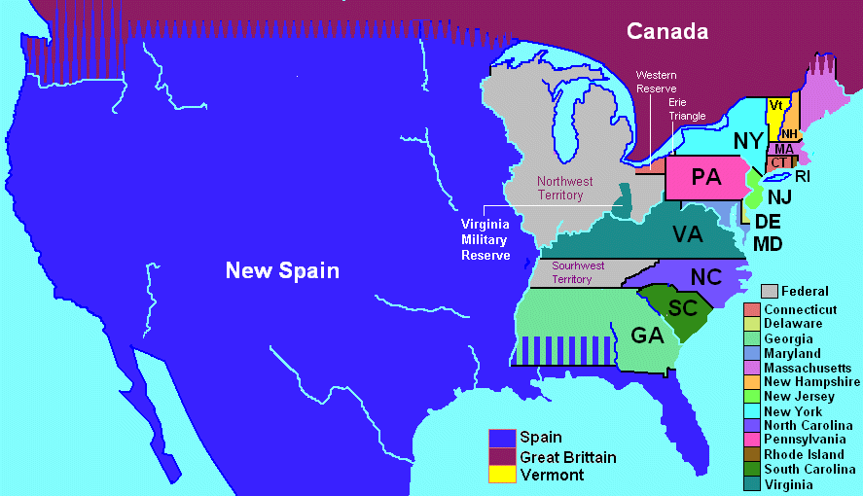
Pinckney’s Treaty 1795

Slide 20
Jay’s Treaty
British agreed to leave Northwest Territory, but could continue fur trade on American side of the US-Canada border
This upset frontier settlers who did not want the British trading on their side of the border

Slide 21
Adam’s Presidency

Slide 22
Election of 1796
John Adams (Federalist candidate) v. Thomas Jefferson (Democratic-Republican Candidate)
Adams is elected President, and Jefferson Vice President (he had the second most electoral votes)

Slide 23
Adams’ electoral votes
Sectionalism: placing the interest of one region over the interests of the nation as a whole
Jefferson’s electoral votes

Slide 24
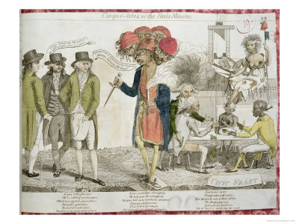
XYZ Affair

Slide 25
XYZ Affair
France thought Jay’s Treaty violated their alliance
France refused to receive the American ambassador and seized U.S. ships
Adams sent a team to negotiate with the French, but the French sent 3 low-level officials (X, Y & Z) and demanded a 250,000 bribe.
“Millions for defense, but not one penny for tribute”

Slide 26
Alien and Sedition Acts
Made Adams very unpopular
Gave government the power to jail aliens or anyone who spoke out against the government
Democratic-Republicans called it a violation of the 1st Amendment

Slide 27
Virginia and Kentucky Resolutions
Jefferson and Madison encouraged states to pass resolutions against the Alien and Sedition Acts.
Virginia and Kentucky were the only states to do so
Nullification: states had the right to nullify any act of Congress they deemed unconstitutional
Showed that the balance of power between the states and federal government was still an issue.

