Slide 1
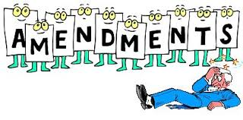
The Bill of Rights
Unit 1 Part II

Slide 2
1st
Freedom of religion, speech, press, assembly, and to petition the government

Slide 3
2nd
Right to bear arms

Slide 4
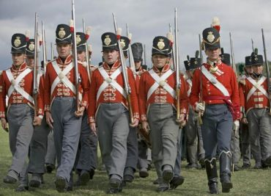
3rd
No quartering troops

Slide 5
4th
No search and seizure without a warrant

Slide 6
5th amendment
Rights of the accused
Right to trial
No double jeopardy
Protection against self-incrimination
Right to due process
Eminent domain

Slide 7
6th amendment
Right to fair trial
Speedy
Public
Unbiased jury
Right to an attorney
Right to bring witnesses

Slide 8
7th amendment
Right to a jury in a civil case (over $20)

Slide 9
8th
No cruel, unusual punishment
No excessive bail or fines

Slide 10
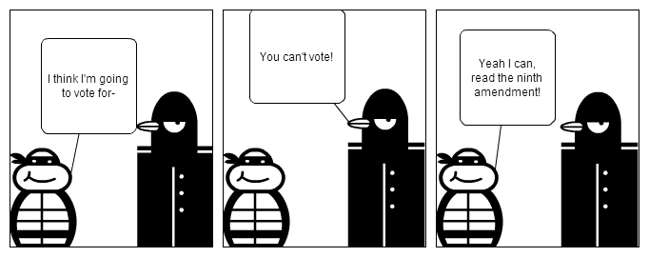
9th
Rights are not limited to those listed in the Constitution

Slide 11
10th
Reserved powers (any power not specifically given to the national government or prohibited to the states, belongs to the states)
“States’ rights” amendment

