Slide 1
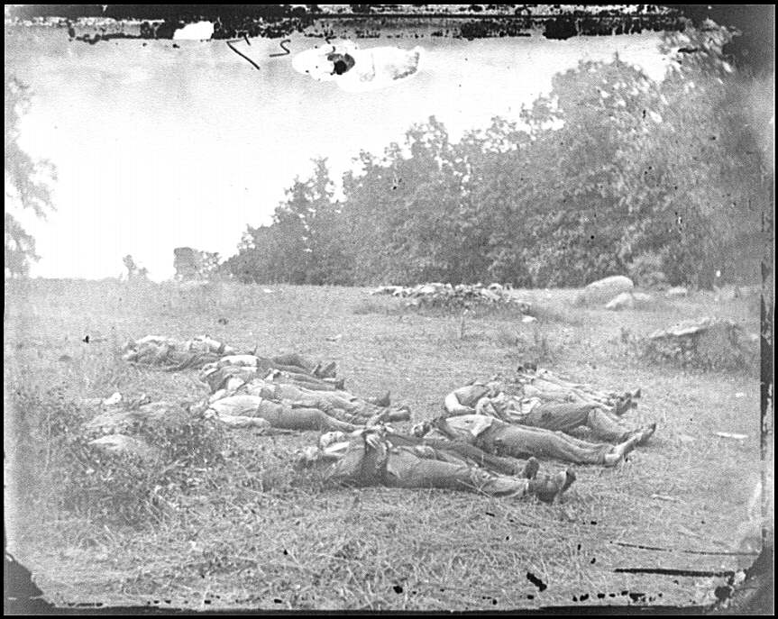
The civil war

Slide 2
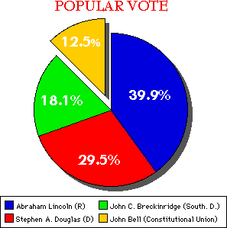
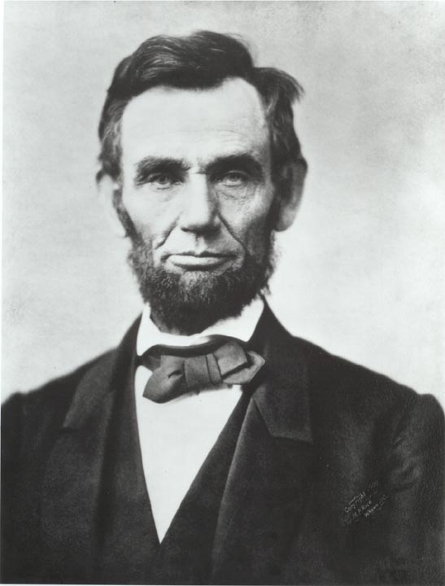
How does the Civil War begin?
Election of 1860 – Lincoln is elected
As a result, South Carolina secedes from the United States

Slide 3
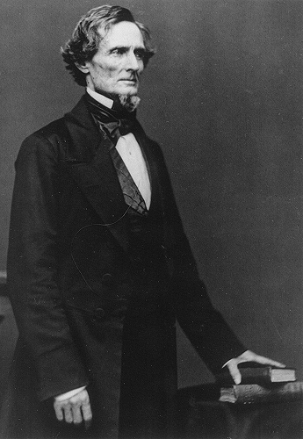
How did the Civil War begin?
April 1861, the Confederacy demanded that the Union surrender Fort Sumter, in Charleston.
President Lincoln did not want to start a war, but he also could not abandon the fort. He cleverly sent in “food for hungry men”.
Jefferson Davis, president of the Confederacy, attacked the fort and seized it, starting the Civil War.
Jefferson Davis

Slide 4
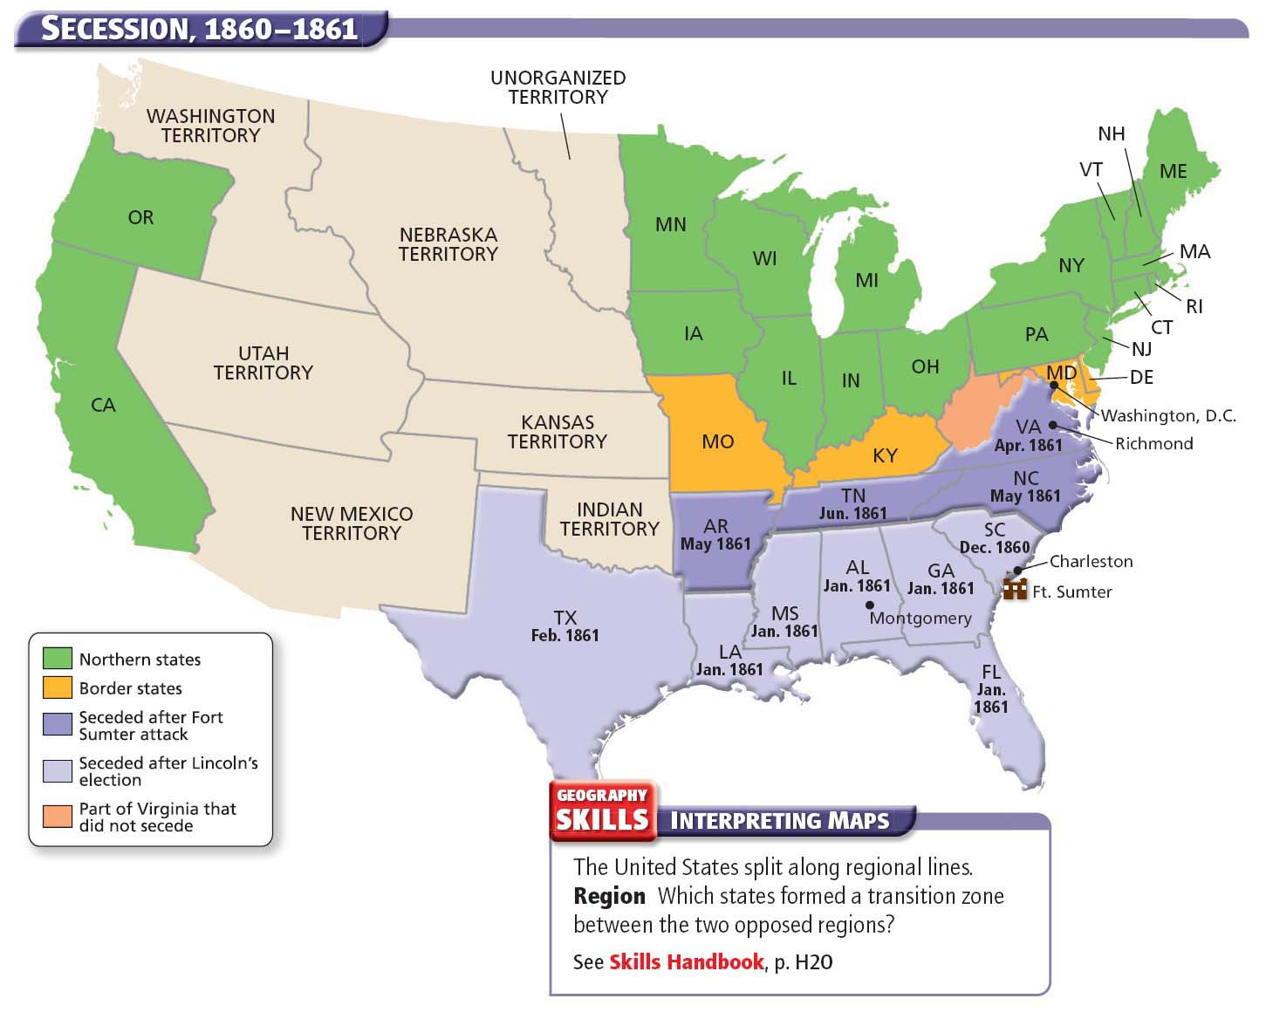

Slide 5
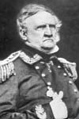
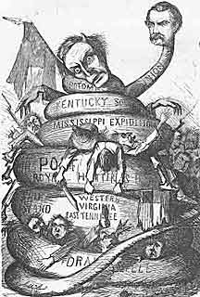
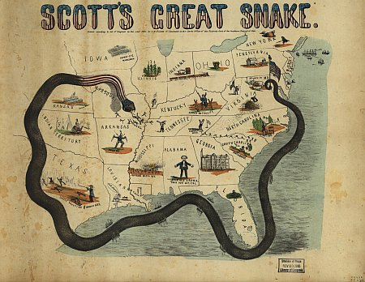
Anaconda Plan

Slide 6
Anaconda Plan
Union’s strategy to win the war
  Blockade southern ports
  Split the Confederacy in two by taking control of Mississippi River
  Capture Richmond, VA, the capital of the Confederacy

Slide 7


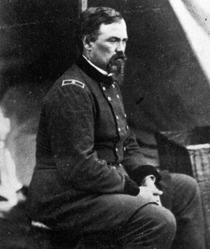
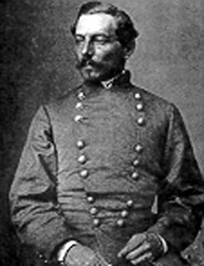
Generals at Bull Run
General McDowell vs. General Beauregard

Slide 8
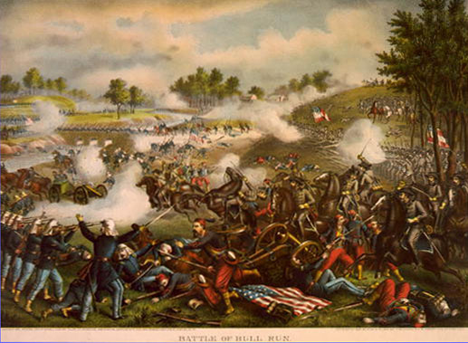
Battle of Bull Run
First major battle of the Civil War
Only 25 miles from Washington, D.C.
South won and southern general Stonewall Jackson won his nickname because he stood firm in battle

Slide 9
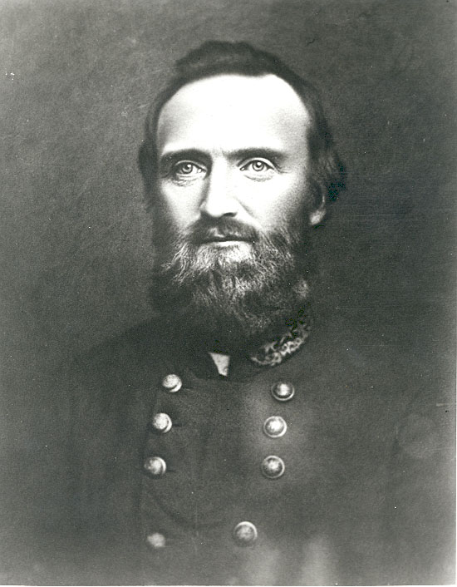
Thomas “Stonewall” Jackson

Slide 10
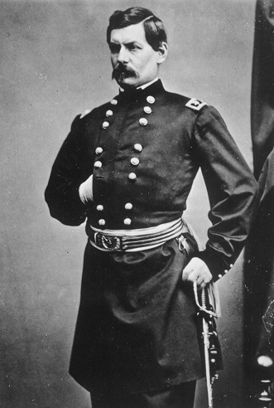
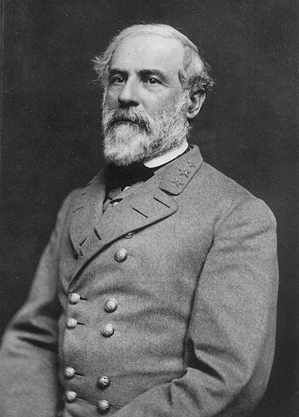
Battle of Antietam
September 1862
George McClellan
Robert E. Lee

Slide 11
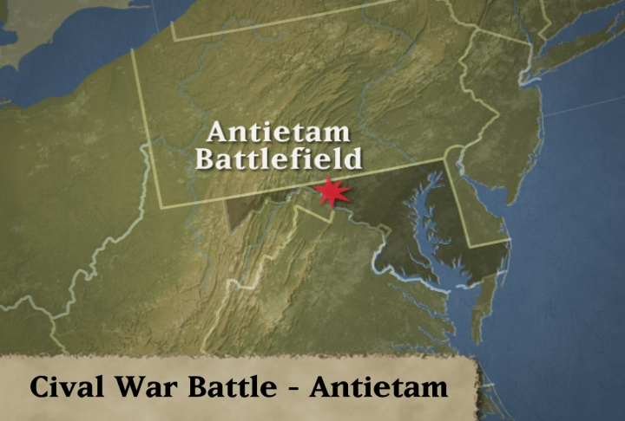
Antietam: Sharpsburg, Maryland
Bloody battle in Maryland resulted in a tie and Robert E. Lee’s army has to retreat back into Virginia. Lee attacked the north because he needed a victory on northern soil.

Slide 12
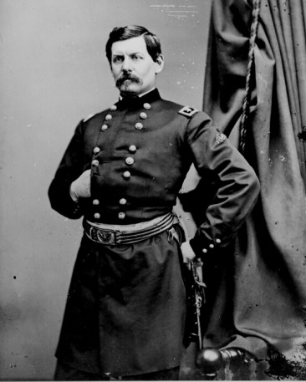
Antietam
Union troops did not chase Lee back into Virginia
If they had, they might have won the war then and there
Lincoln fired McClellan in November 1862
General McClellan

Slide 13
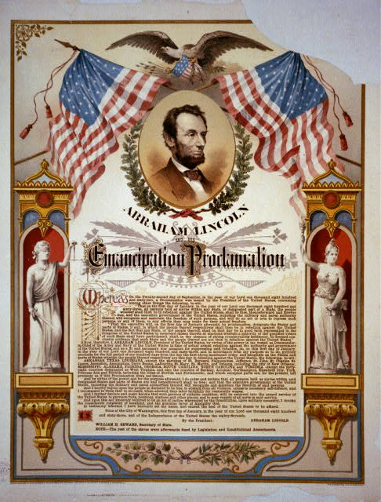
Emancipation Proclamation
It freed the slaves only in states that have seceded from the Union.
It did not free slaves in border states.
Notes:
13

Slide 14
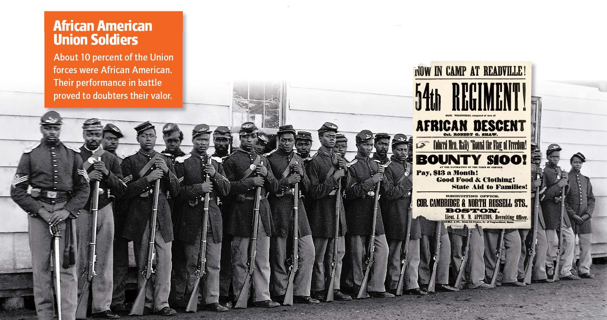

Slide 15
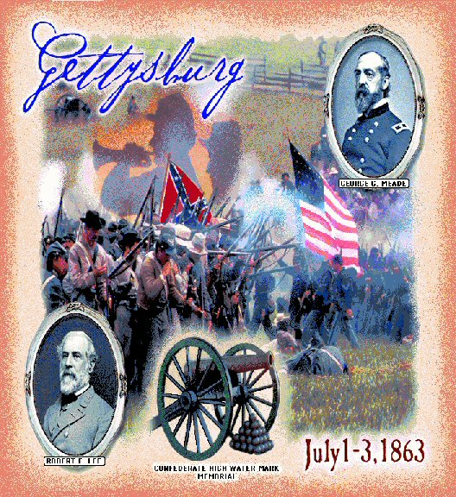
Notes:
15

Slide 16
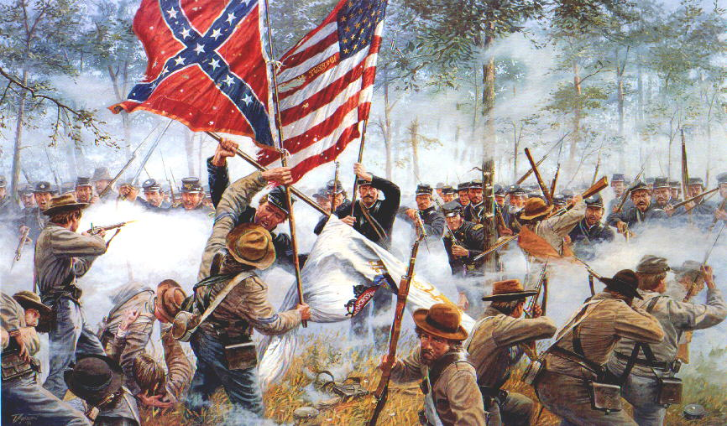
Gettysburg – turning point
In 1863, General Lee decided again to invade the North. His army met Union forces at Gettysburg, Pennsylvania.
The Union won after three days of fierce fighting
Over 100, 000 people died in 3 days →It was the last time the South invaded the North.
Gettysburg was considered a turning point in the war because Northerners gained new life after finally defeating Lee’s army
Notes:
16

Slide 17
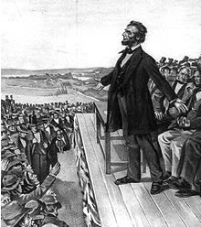
Gettysburg Address
that from these honored dead we take increased devotion to that cause for which they gave the last full measure of devotion -- that we here highly resolve that these dead shall not have died in vain -- that this nation, under God, shall have a new birth of freedom -- and that government of the people, by the people, for the people, shall not perish from the earth.
        Abe Lincoln
Notes:
17

Slide 18
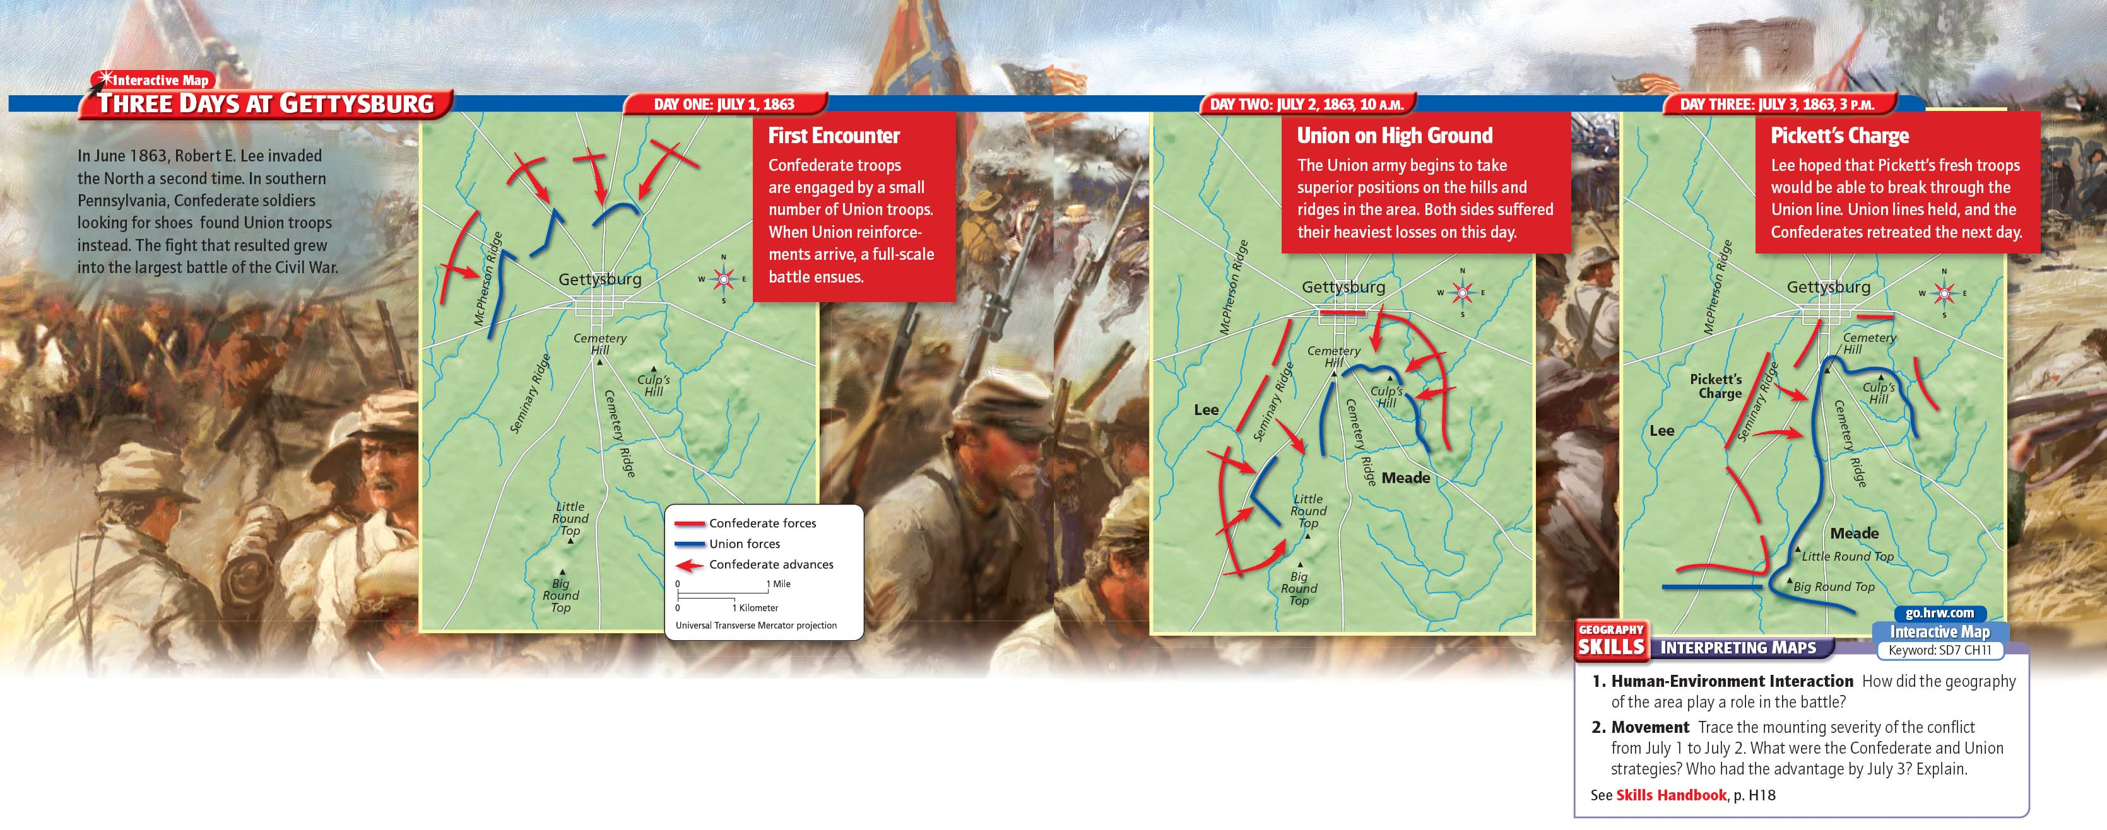

Slide 19
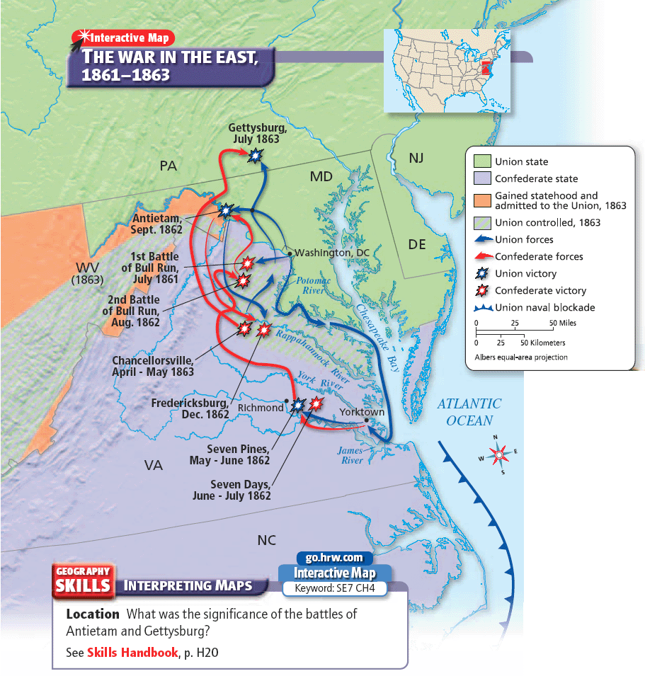

Slide 20
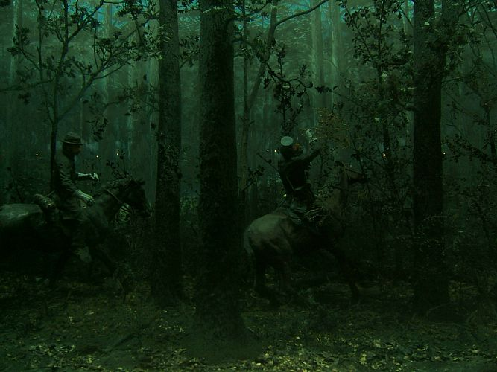
Chancellorsville, Virginia
Confederate victory in 1863
Stonewall Jackson was shot and killed accidentally by his own troops.

Slide 21
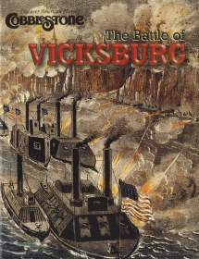
c
Notes:
21

Slide 22
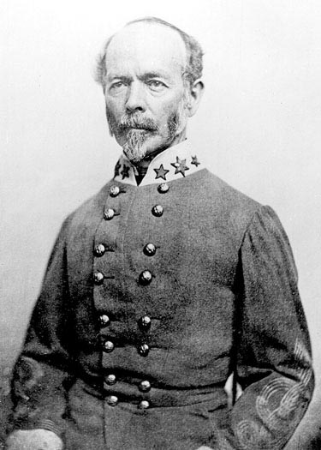
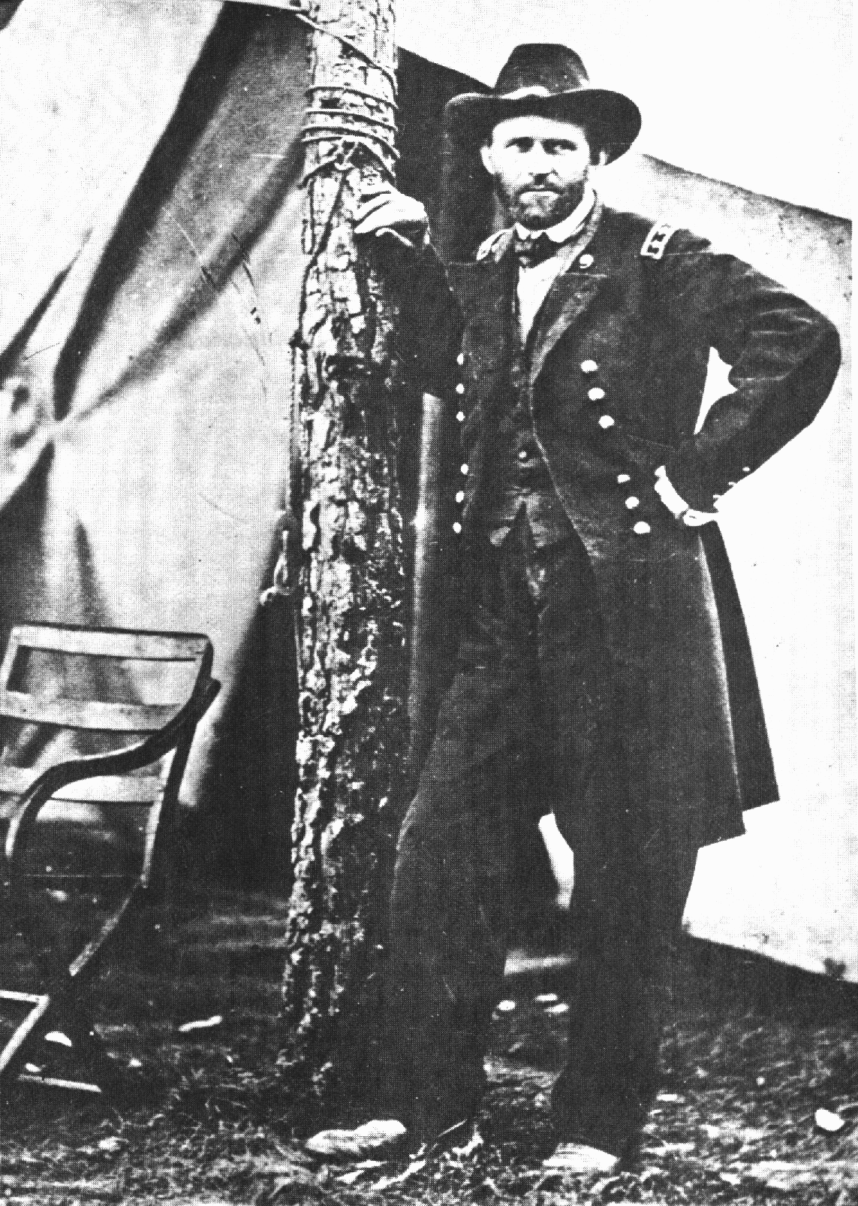
Battle of Vicksburg – July 1863
Gen. Albert Johnson
General Ulysses S. Grant

Slide 23
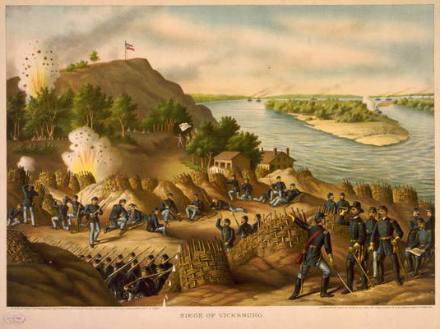
s
July 4, 1863 - another Union victory - VICKSBURG
The day after Gettysburg, General Grant captured Vicksburg, Mississippi for the Union
This was a significant win for the Union because now the Union controlled the Mississippi and split the Confederacy in two
Lincoln made Ulysses S. Grant commander of all Union armies

Slide 24
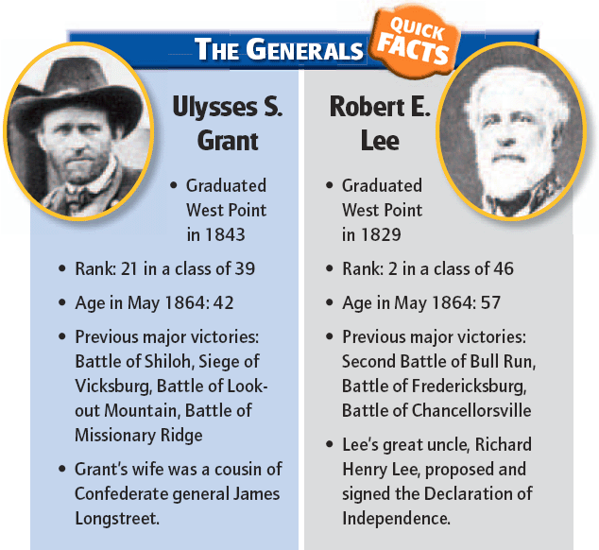

Slide 25
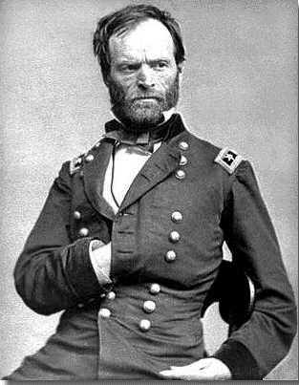
William Tecumseh Sherman
Grant gave the military division of the Mississippi to Sherman.
Both generals sought a total victory over the South.
This meant not only conquering the South’s army and government, but also its civilian population.

Slide 26
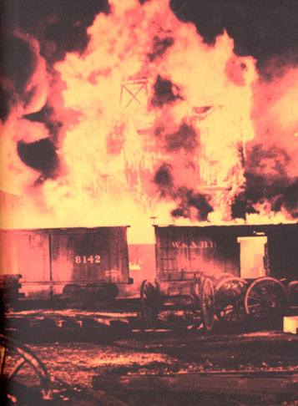
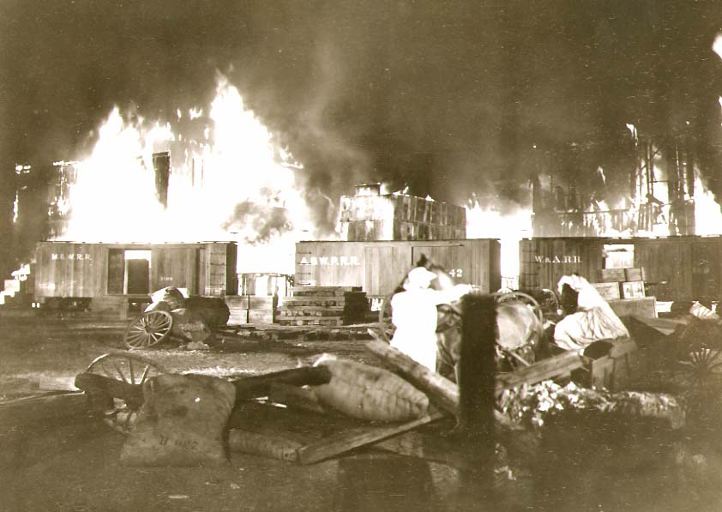
Battle for Atlanta
In September 1864, Sherman captured Atlanta and burned much of it to the ground.

Slide 27
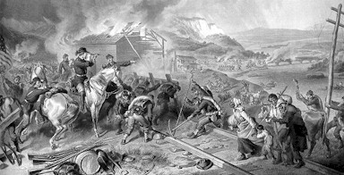
Sherman’s March to the Sea
On November 12, 1864, Sherman marched out of Atlanta toward the Atlantic coast.
Tracing a line of march between Macon and Augusta, he carved a sixty-mile wide swath of destruction in the Confederacy's heartland.

Slide 28
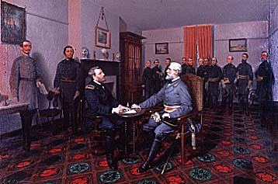
Grant pursued Lee’s army into Virginia
Sherman’s troops invaded Georgia and destroyed farms and cities on their way to the sea
April 3, 1865, Grant took Richmond, VA
Lee surrenders on April 9, 1865 at APPOMATTOX COURTHOUSE

Slide 29
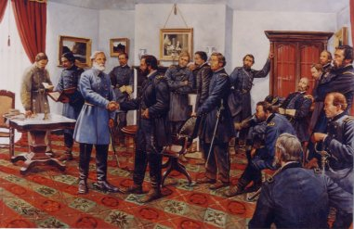
Lee Surrenders
Appomattox Courthouse

Slide 30
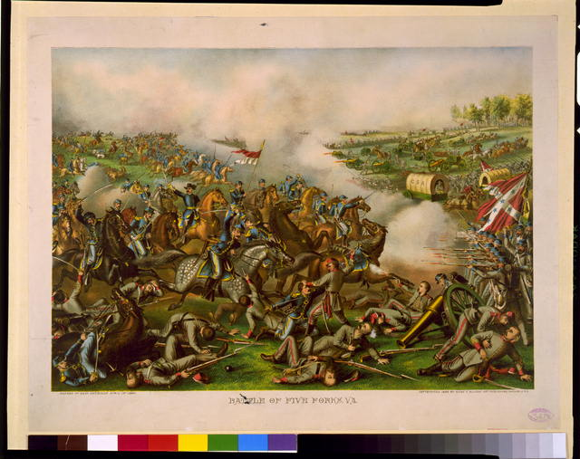
After four bloody years of civil war,
the South was defeated.
Notes:
30
On slide: Graphic.
Click 1: After four bloody years…
Click to next slide.

Slide 31
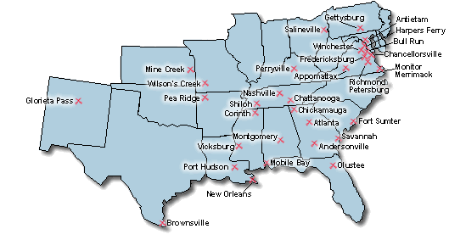
Battle Maps

Slide 32
Over 618,000 military deaths during Civil War.
Notes:
32

Slide 33
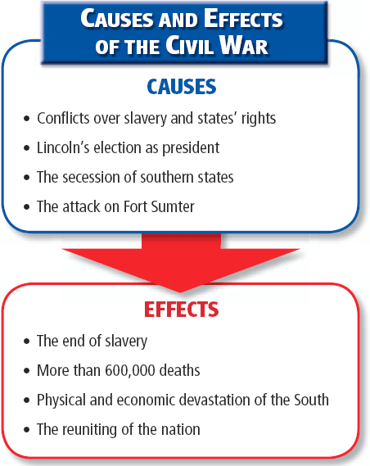

Slide 34
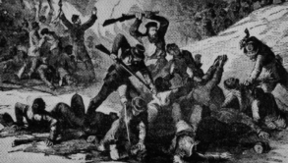
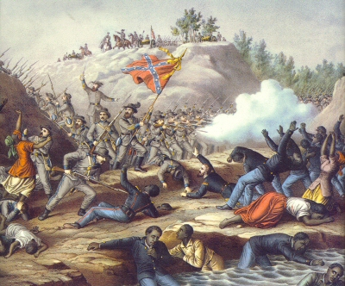
Atrocities of the Civil War
Massacre at Fort Pillow
200 captured African Americans were murdered

Slide 35
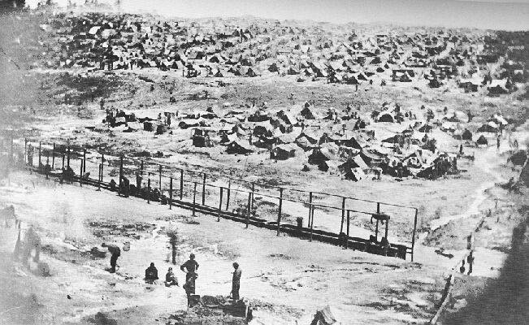
Union Prison Camp
at Andersonville, GA

Slide 36
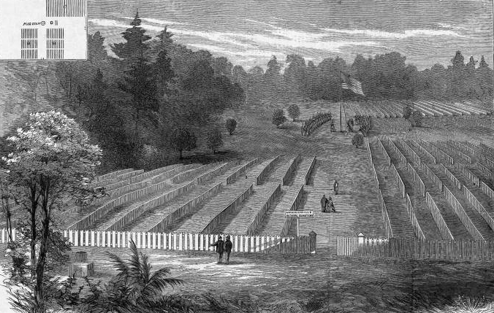
Original Andersonville Plan
Planned to hold 10,000 men.
Had over 32,000 at one time.

Slide 37
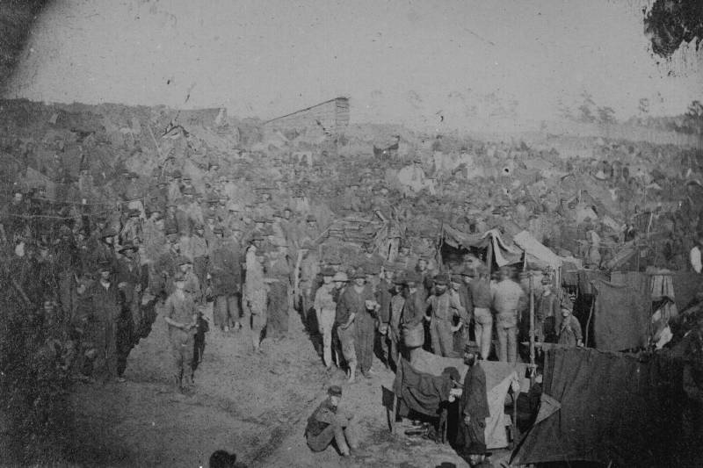
Distributing “Rations”

Slide 38
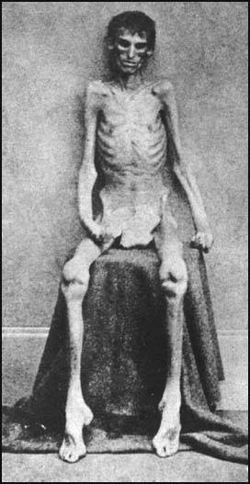
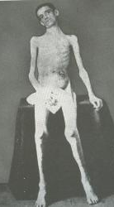
Union “Survivors”

Slide 39
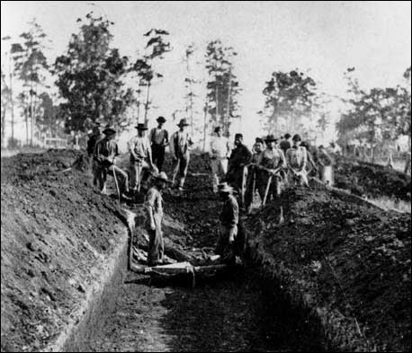
Burying Dead Union POWs

