Slide 1
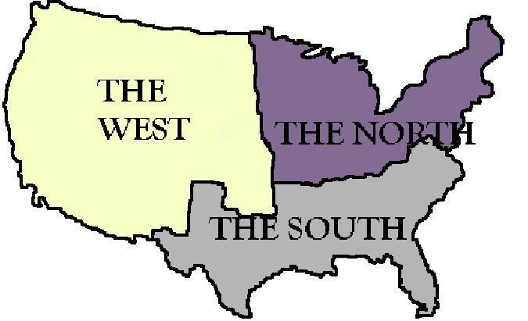
Growing Sectionalism
How did social and economic disparity contribute to the rise of sectionalism?

Slide 2
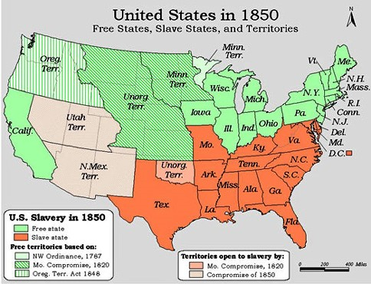
Sectionalism
By the mid-19th century, distinct regions were developing in the U.S.

Slide 3
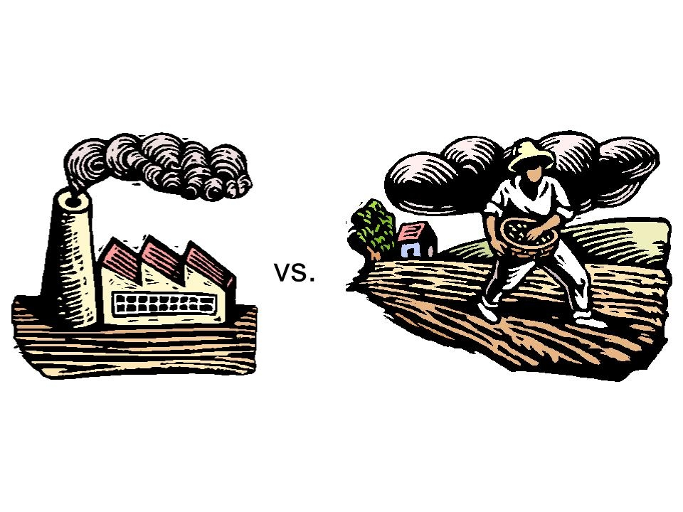
Sectionalism
Sectionalism: loyalty to the region rather than the nation as a whole
developed due to the social and economic disparity between the North and the South.

Slide 4
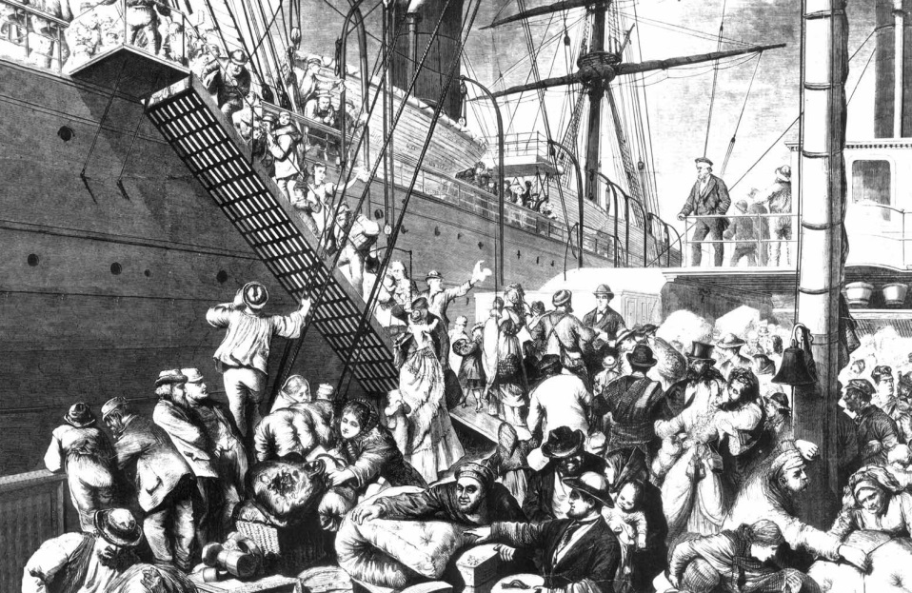
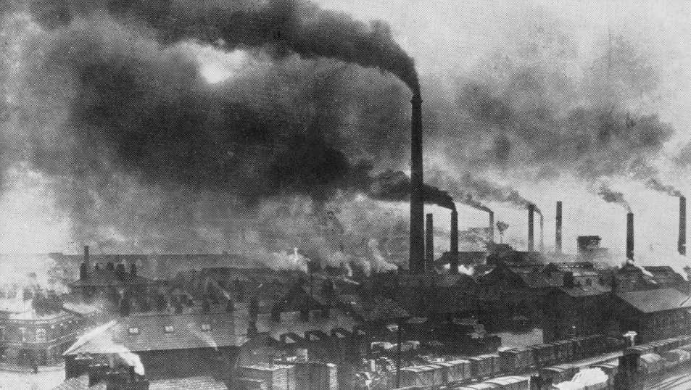
The North
The North and some parts of the Mid-west were increasingly industrialized and also had a growing immigrant population.

Slide 5
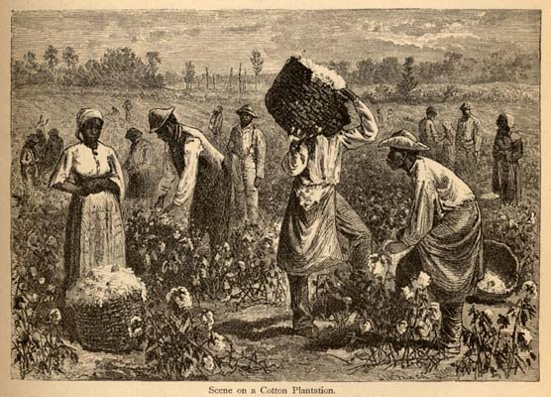
The South
The South still relied heavily on agriculture and slave labor. The population was smaller and politics were dominated by wealthy plantation owners.

Slide 6
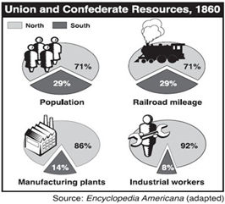
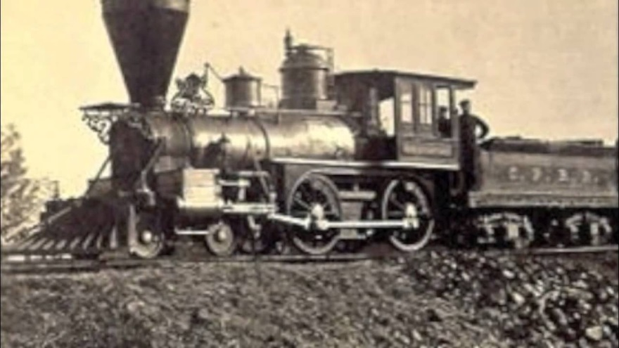
Economic Disparity
The North had more manufacturing, food production, larger population and much more functioning railroads than the South.

Slide 7
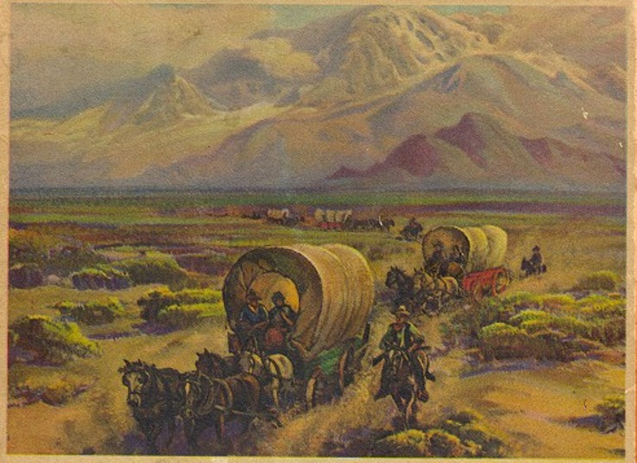
The West
As more settlers moved west, the North and the South fought over whether these new territories and states would be free or slave

Slide 8

Stop and Think!
Why do you think this was such a hot topic? Why did the North and the South care about slavery in the West?

Slide 9
The Nullification Crisis
Should a state have the right to nullify federal law?
Who decides if a law is unconstitutional?
The Supreme Court? The President? Congress? The States?

Slide 10
The Problem
The Tariff of 1828 helped industry in the North, but the farming economy of the south was being hurt by the law.
  Cotton prices dropped from 31 cents per pound to 8 cents per pound in less than ten years.
  South Carolina leads to protest against what they saw as an unconstitutional law by “nullifying” it.

Slide 11
Who created the Constitution and what kind of government was created?
Supporters of Nullification
  The people form the states, and the states form the federal gov.
Opponents of Nullification
  The people came together to directly form the federal gov.
    Preamble to the Constitution = “We the PEOPLE…”

Slide 12
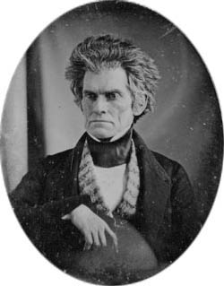
What documents do they use to support their position?
Supporters:
  Virginia and Kentucky Resolutions of 1798
  10th Amendment
  John C. Calhoun (Vice President and South Carolinian) published “Exposition and Protest” anonymously.

Slide 13
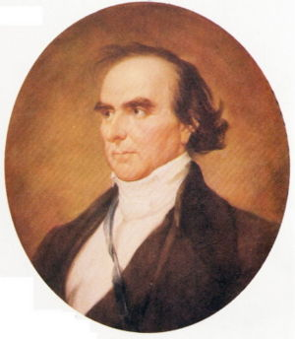
What documents do they use to support their position on Nullification?
Opponents of Nullification
  The supremacy of the national government based on the Supremacy Clause (Article VI) of the Constitution.

Slide 14
Who would support this position?
Pro-Nullification
Anti-Nullification
Led by Vice President John C. Calhoun
Southern planters who rely on cotton and slavery
Those who believe in states’ rights ideology (states should have more power than federal government)
Led by President Andrew Jackson
Merchants (mostly Northerners) who like the Tariff
Those supporting the authority of the federal government

Slide 15
Decision Point: Nullification
The Problem
Possible Solutions
The Tariff of 1828 angered many Southern states because it hurt their economy.
South Carolina “nullifies” the Tariff.
Send in the military and force South Carolina to obey.
    Could lead to war
Revoke the Tariff of 1828.
    Makes the federal government look weak
Compromise
    Describe how you would “meet in the middle”

Slide 16
Stop and Think!
How could you compromise and solve this problem?

Slide 17
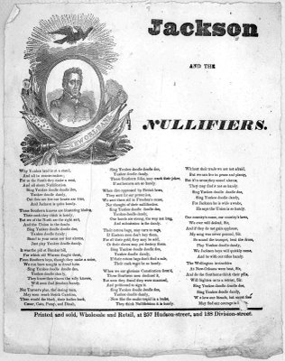
Nullification Crisis: What Happened?
1832- SC calls a convention and nullifies the tariff and threatens secession creating major national crisis.
Jackson signs the Force Bill and Tariff of 1833 at the same time.
Force Bill authorizes military action to collect tariffs and prevent secession.
Tariff of 1833 lowers the tax.
“With this hand I offer peace, with this hand I offer war, you choose.” – Andrew Jackson

Slide 18

Nullification Crisis: What Happened?
SC drops nullification, accepts the compromise tariff but nullifies the Force Bill at the same time.
Both sides say they won.

