Slide 1
French and Indian War
Objective: Explain how the French and Indian War laid the groundwork for the American Revolution
EQ: How did the French and Indian War lay the groundwork for the American Revolution?

Slide 2
Directions
In addition to taking notes on the handout, you will answer questions on a separate sheet of paper.
Use the images and maps to answer the questions in blue.

Slide 3
WHO?
Great Britain and France were racing each other to build a world empire.

Slide 4
1. Which countries held claims in North America in 1750? 2. Describe the location of British claims. 3. Describe the location of French claims.

Slide 5
4. Who do you think was interested in the “Land in Dispute”? Why? 5. What is the name of the French settlement we discussed last unit?

Slide 6
WHO?
French settlers and English settlers were very different.
French settlers were mostly fur traders or Catholic Priests, which means they were not looking to make permanent settlements and were usually friendlier with Native Americans.

Slide 7
6. Is this colonist likely French or English? Explain your answer.

Slide 8
Population in the colonies
7. Which empire had the advantage in terms of population in their North American colonies?

Slide 9
8. Why do you think many Native Americans sided with the French during the French and Indian War? List as many reasons as you can.

Slide 10
WHO?
Great Britain
France
English settlers– permanent settlements, larger # of colonists
French settlers– fur traders, Catholic priests, better relations with Native Americans
Native Americans – many sided with French, but some had alliance with British (Iroquois)

Slide 11
WHY?
Anglo-French Imperial Competition (in other words Great Britain and France were competing with each other to acquire the most colonies)
Dispute over land in Ohio River Valley

Slide 12
9. Why do you think the British became interested in expanding into the Ohio River Valley? 10. What do you think kept British colonists from wanting to expand into this region earlier?

Slide 13
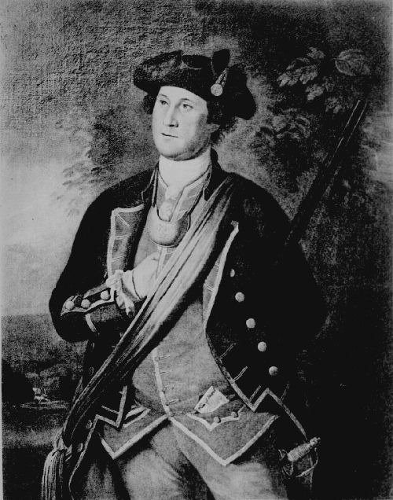
WHERE? **Don’t write yet!!
The French built a fort on the site of modern day Pittsburg, but the British had already granted 200,000 acres of land in the area to the wealthy planters.
So, the Virginia governor sent a militia, led by a young George Washington to kick out the French.

Slide 14
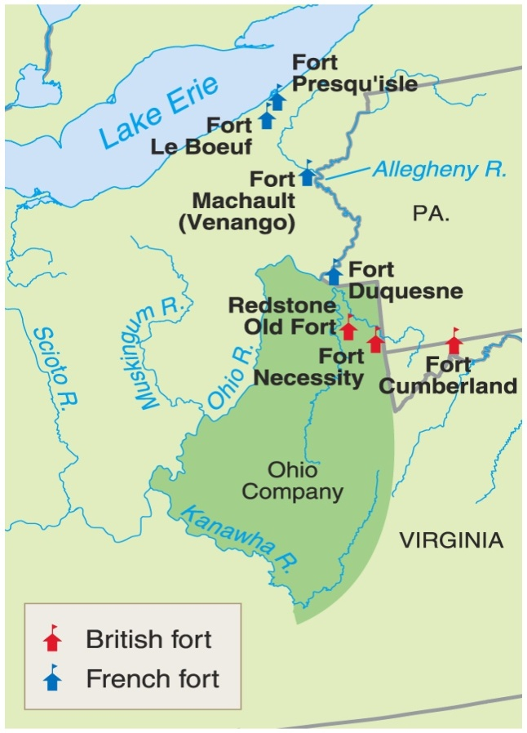
1754 → The First Clash
The Ohio Valley
British
French
Fort Necessity Fort Duquesne * George Washington * Delaware & Shawnee Indians

Slide 15
WHERE?
Begins at Fort Necessity (near modern-day Pittsburg) in Ohio River Valley

Slide 16
11. In what general region were the battles fought during the French and Indian War?

Slide 17
WHERE?
Begins at Fort Necessity (near modern-day Pittsburg) in Ohio River Valley
Fought mostly in Northeast
Quebec

Slide 18
12. What body of water was the settlement at Quebec located on?

Slide 19
13. Using this picture, describe how the British attacked Quebec. 14. How was this different from how the British fought traditionally?

Slide 20
HOW?
Early on, British suffer many defeats
1759 – tide turns with British victory at Quebec

Slide 21
In 1759 the tide turned for the British. At night, British troops scaled the high cliffs that protected Quebec and took the French by surprise. This British victory at Quebec led them on to victory in the war.

Slide 22
Treaty of Paris (1763)
The war officially ended in 1763 with the Treaty of Paris.
Great Britain claimed all of the land east of the Mississippi, including Florida (which they got from Spain)
Spain gained all of the French lands west of the Mississippi.
**(Spain becomes an ally of France after the war starts)

Slide 23
15. Describe the changes in British claims as a result of the 1763 Treaty of Paris. 16. What happens to French claims in North America in 1763?

Slide 24
HOW?
Early on, British suffer many defeats
1759 – tide turns with British victory at Quebec
1763 Treaty of Paris officially ends the war

Slide 25
WHEN?
1754-1763

Slide 26
SIGNIFICANCE?
1763 Treaty of Paris laid the groundwork for American Revolution
How?

Slide 27
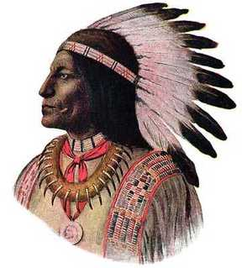
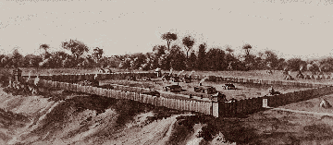
Aftermath of the War
Native Americans are afraid the British settlers moving west will destroy their way of life
They attack British forts
Example: Pontiac’s Rebellion

Slide 28
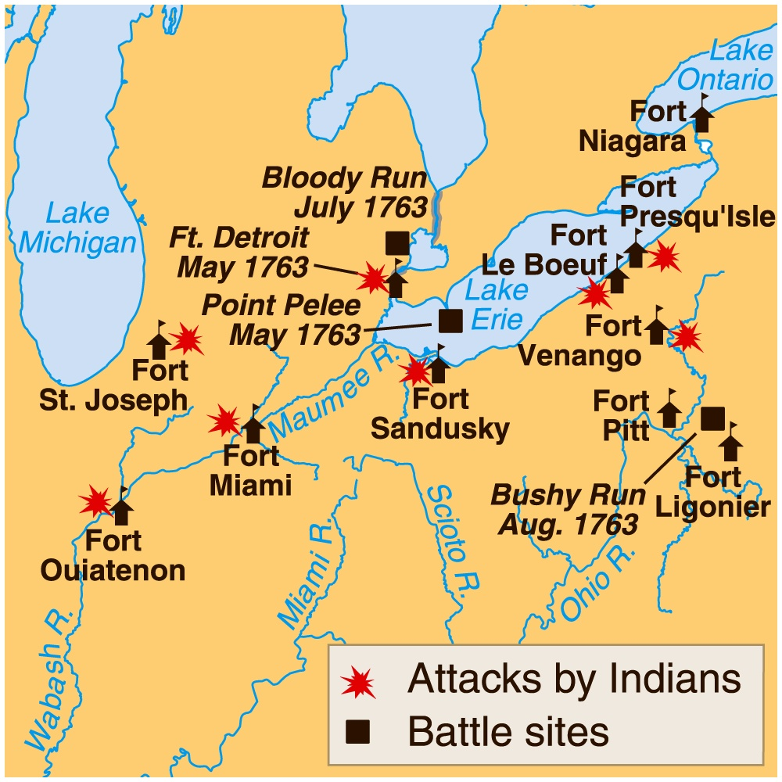
Pontiac’s Rebellion (1763)

Slide 29
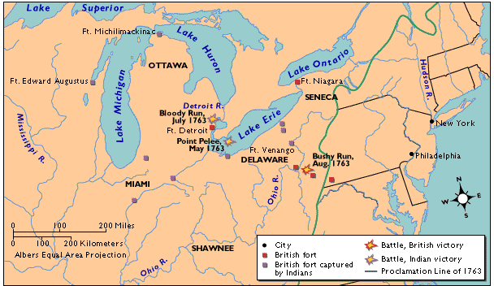
So … the British issue the Proclamation Line of 1763.
17. How do you think the colonists felt about the Proclamation line of 1763?

Slide 30
Tension between the British and the colonists
Another Issue = Taxes
The British believed that the colonists should pay for the war.

Slide 31
George Grenville’s Program, 1763-1765
1. Sugar Act - 1764
2. Currency Act - 1764
3. Quartering Act - 1765
4. Stamp Act - 1765

Slide 32
SIGNIFICANCE?
1763 Treaty of Paris laid the groundwork for American Revolution
Increased tensions between British and colonists
Proclamation of 1763
Taxes to pay for debt

Slide 33
CAUSES
On your handout, describe the causes of the French and Indian War IN YOUR OWN WORDS

Slide 34
Effects of the War on Britain?
1. It increased her colonial empire in the Americas.
2. It greatly enlarged England’s debt.

Slide 35
Effects of the War on the American Colonials
1. United colonists (fighting against a common enemy and resentment towards British)
2. British crack down on smuggling and increase taxes to pay war debt

Slide 36
EQ: How did the French and Indian War lay the groundwork for the American Revolution?
Answer the EQ in complete sentences on your content map!

