Slide 1
The Era of Good Feeling
What is the significance of the Monroe Doctrine?

Slide 2
Monroe Doctrine
European monarchs start to look at South America for colonies.
Monroe fears European powers entering the Western Hemisphere
May effect US foreign markets

Slide 3
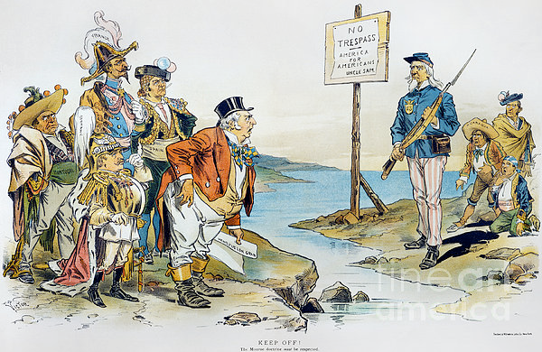
Monroe Doctrine
President James Monroe issues his Monroe Doctrine
European powers… stay out of our hemisphere, or else we will attack you!!!
England supports the doctrine, and they will attack any country that violates it as well

Slide 4
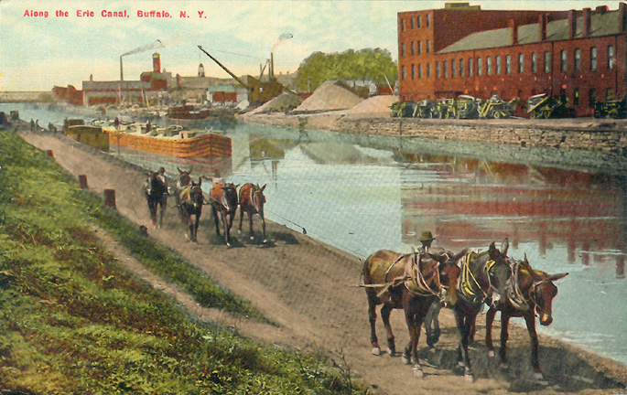
Industrial Revolution
How did economic growth impact the US in the early 19th century?

Slide 5
Erie Canal
1825, the state of New York opens the Erie Canal
Connects the east coast with the interior of the country
Allows for New York to become a center of trade and travel
Helps the US economy because goods can reach places faster and easier

Slide 6
American System
Developed by Henry Clay
1. Internal improvements at federal expense (railways and canals)
2. Protective Tariffs
3. National Bank
Demonstrated the economic and industrial growth of the U.S. in the early 1800s

Slide 7
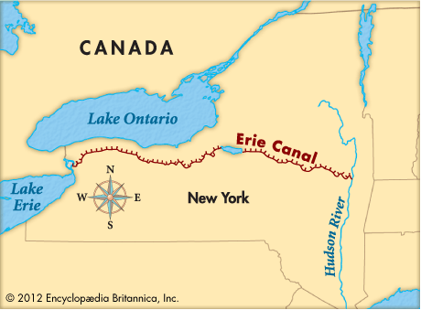
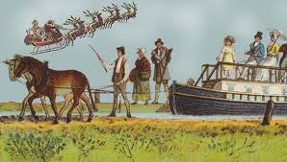
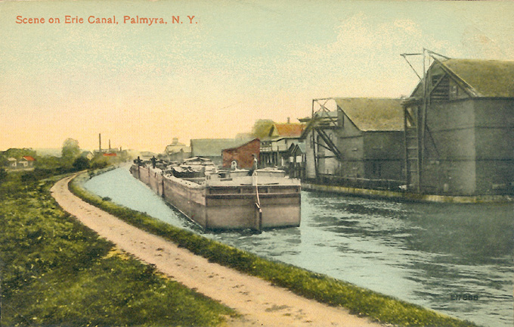

Slide 8
Eli Whitney
Cotton Gin
Allowed for the mass production of cotton by mechanically removing the seeds from the cotton

Slide 9
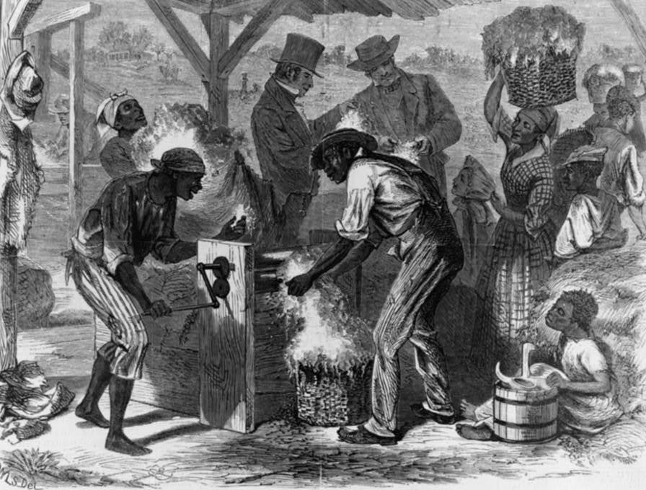
Cotton Gin
Since cotton could be refined faster, it needed to be picked faster
What does this mean for slave labor?

Slide 10
Interchangeable Parts
Whitney decides to create a musket using interchangeable parts (identical parts)
This means if the trigger of the gun broke, you could replace the trigger rather than having to buy a new gun.
Makes production of goods faster, and cheaper

Slide 11
Agricultural changes
Technological innovations made farming more efficient
Led to a farming boom… more food for everyone
Goods were then cheaper because they were mass produced
Mechanical Reaper, Combine machine, Steel Plow

Slide 12
Effect on the American Country
The Erie Canal, interchangeable parts, cotton gin, and other inventions of the time period created cheaper, available goods.
Feelings in the era were good

