Slide 1
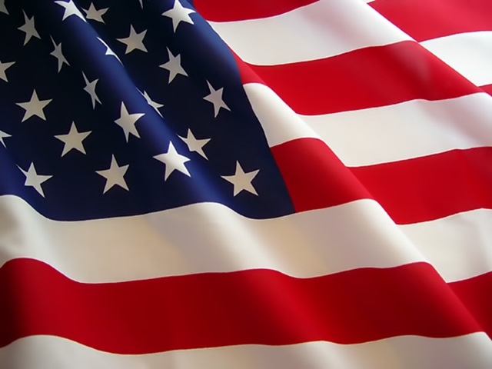
Development of National Identity
DEVELOPMENT OF A
NATIONAL IDENTITY

Slide 2
Objectives
Explain how the War of 1812 helped the development of a national identity (review)
Describe the development of infrastructure
Describe the impact of the “American System” and the Erie Canal on national identity and unity

Slide 3
Essential Questions
How did the War of 1812 help the development of America’s national unity?
How did the nation’s infrastructure develop?

Slide 4
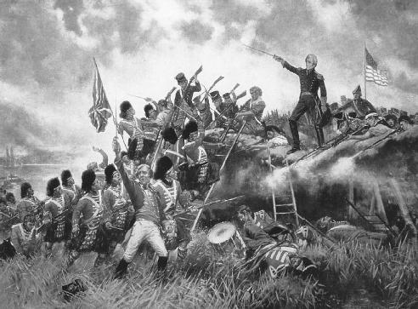
The War of 1812

Slide 5
War of 1812
Who was fighting? U.S. vs. British
Over what? Impressment and British alliance with Native Americans
Who was President? James Madison
How did it end? Treaty of Ghent/Battle of New Orleans → US wins

Slide 6
War of 1812
The development of a national identity:
- Confirmed American independence (we could hold our own as a country)
- Strengthened nationalism
British burned the White House
Battle of New Orleans

Slide 7
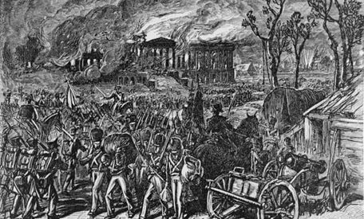
War rallied people together, and the burning of the White House made people especially angry (think about how we feel about 9-11)

Slide 8
Battle of New Orleans
Americans defeat the British
Andrew Jackson becomes a national hero
(They didn’t know we had already signed an armistice at the Treaty of Ghent)

Slide 9
Sometimes called the “Second Revolution”; we beat the British twice and proved we were truly independent

Slide 10
So, let’s stop and think …
How did the War of 1812 strengthen nationalism/help to create a sense of national identity?

Slide 11
Confirmed American independence
Strengthened nationalism (common purpose, common enemy, national pride)
Battle of New Orleans (Jackson = national hero)

Slide 12
Infrastructure
Essential Question:
How did the nation’s infrastructure develop?

Slide 13
What is “Infrastructure”?

Slide 14
“American System”
So… we defeated the British, established ourselves as a country - where do we go from here?

Slide 15
Madison presented a plan to Congress to unify the regions of the U.S. and create a strong, stable economy.
Improve transportation and make other internal improvements
Tariffs on European goods
Bring back the National Bank
** This could make America financially independent of Britain and other European nations

Slide 16
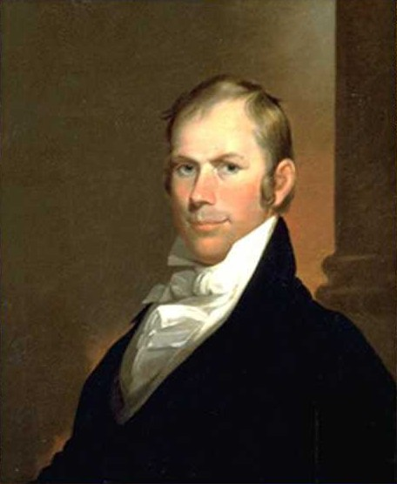
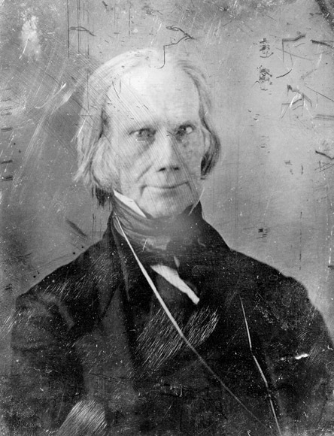
Henry Clay
Weren’t Portrait artists nice?

Slide 17
House speaker Henry Clay (who had been a strong critic of Madison) rallied behind the plan and called it the “American System”

Slide 18
The major goals of the plan were to unite the nation’s economic interests and make America economically independent from Britain and other European nations

Slide 19
“The American System”
North manufactures goods that the South and West buy
The South and the West grow the grain, meat, and cotton needed in the North

Slide 20
Transportation
For people in different regions to do business together, better roads and canals were needed
toll roads and highways
Canals
(the United States did have some railroads, but most transportation was still accomplished by roads and canals)

Slide 21
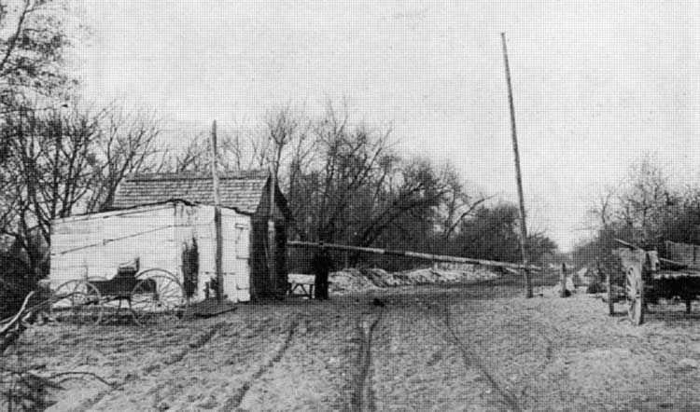
Development of Infrastructure
Toll at a turnpike in New York

Slide 22
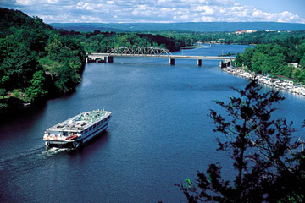
Erie Canal a.k.a. “The Big Ditch”

Slide 23
Erie Canal
363 Miles long
Took 8 years to dig
Finished in 1825
Linked the Hudson River to Lake Erie, basically linking the Atlantic Ocean to the Great Lakes
Opened up new areas for settlements and united the region
Made New York City the most dominant port and the leading commercial city in the United States (connected NYC to European markets and the interior of the United States).

Slide 24
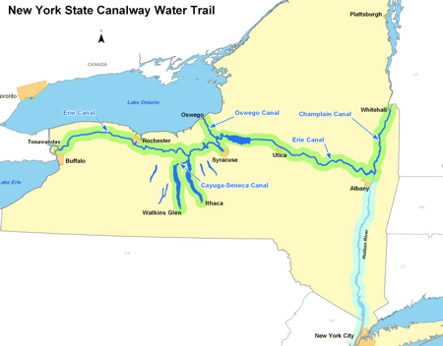

Slide 25
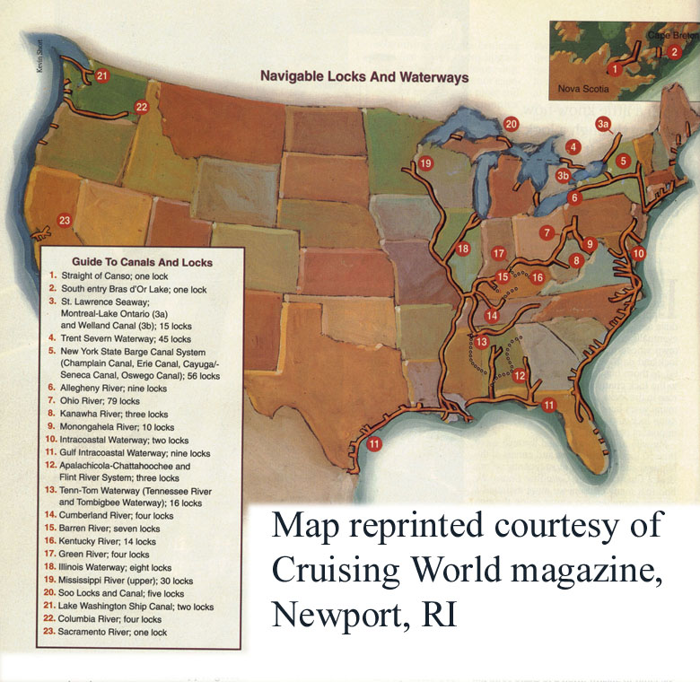

Slide 26
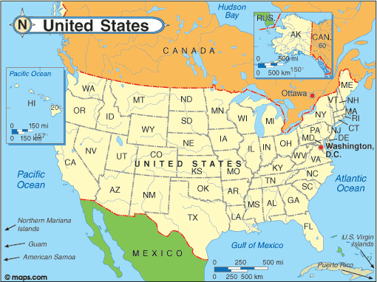

Slide 27
So, let’s stop and think …

Slide 28
How do you think the development of infrastructure could increase a sense of national identity in the United States?

Slide 29
How do you think the development of infrastructure might impact the economy of the United States?

