Slide 1
American Revolution
What was the significance of the American Revolution?

Slide 2
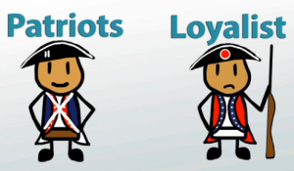
Americans choose sides…
Loyalists: those who opposed independence and remained loyal to the crown.
Patriots: those who wanted independence and to cut ties with Britain.

Slide 3
British
Advantages
British Navy
British Army very well trained and supplied
Manufacturing capabilities
Parliament can impose taxes to pay for it
Disadvantages
No allies
Have to hire mercenaries
3000 miles away from colonies
Poor communication
Americans don’t play by the rules
Nature of American terrain
Bad roads, rivers, swamps

Slide 4
Americans
Advantages
Defending their homes from invaders
Passionate belief in the cause
Realized it would be a long struggle
Incredible quality of leadership
Disadvantages
Have to build up army and navy
No factories
Not united- no centralized government
Internal divisions (Loyalists)
Indians on frontier ally with British.
No treasury

Slide 5
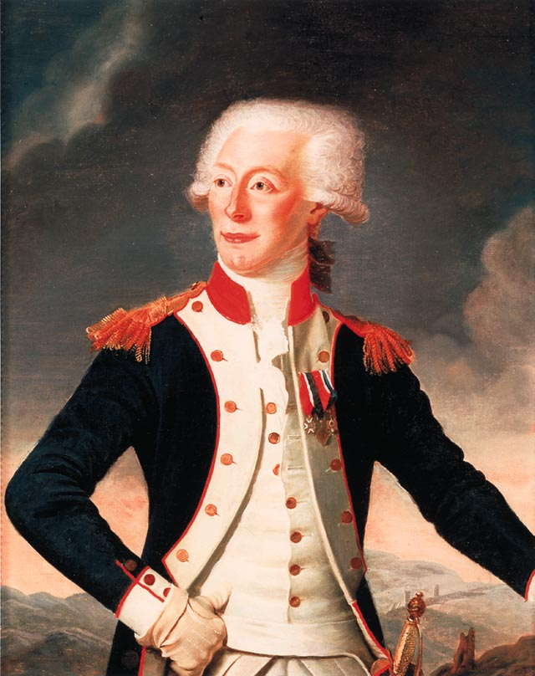
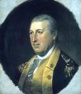
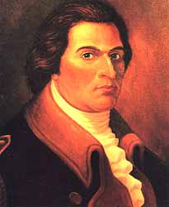
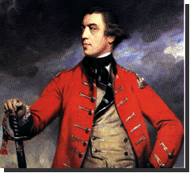
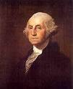
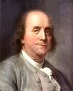
People of the Revolution…

Slide 6
George Washington
Commander in Chief of Continental Army
Displayed extraordinary leadership, reorganized the army and kept his men supplied and together long enough to outlast the British.

Slide 7
Marquis de Lafayette
Frenchman
Trained American forces
Introduced a system of progressive training being with the school of the soldier- trained with and without weapons.

Slide 8
Baron von Steuben
French major
Aided the colonists
Sent French aid in the form of money, arms, and supplies.

Slide 9
General John Burgoyne
British general
Planned on invading NY but was defeated by Gates at Saratoga.

Slide 10
Horatio Gates
Lead of the New England militia
Given credit for defeating British General Burgoyne at Saratoga

Slide 11
Benedict Arnold
Colonel of the CT militia who helped Gates win at Saratoga
After going into debt he was caught plotting to surrender West Point to the British.
Most famous American traitor.

Slide 12
General Cornwallis
British commander
Surrendered to the Continental Army at Yorktown.

Slide 13
Ben Franklin
Renaissance Man
Successful at everything he tried
Not a rich man but realize his own potential by his own will and ambition.
US ambassador to France during American Revolution

Slide 14
Battles of the American Revolution
Teacher: Refer to word document for step in directions and questions
Step into the Scene!
You will be shown paintings of the important battles.
Your job is to take on the role of the persons you see in the scence

Slide 15
Battle of Trenton 1776
Washington’s army was hurting
Christmas night Washington would make a bold move.
Led 2400 men in rowboats across Delaware River
March to Trenton, NJ where Hessians were still sleeping
Washington’s army killed 30 and took 918 captive with 6 Hessian cannons.
American victory brings new hopes.

Slide 16
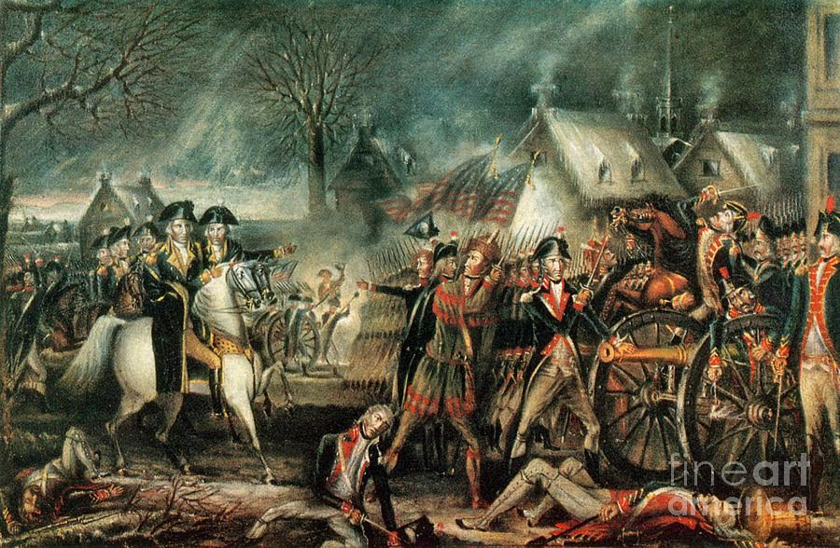
Battle of Trenton 1776
Hessian
Washington
Colonial

Slide 17
Victory at Saratoga 1777
American troops led by General Horatio Gates finally surrounded British General Burgoyne and his men at Saratoga, NY.
Burgoyne would surrender on October 17, 1777.
After this loss British war strategy would change
Keep troops close to the coast and near the big guns and supply bases of the British fleet
Ben Franklin was in France trying to negotiate an alliance…
Showed the French that Americans could win the big battles- Turning point- French would agree to support the colonists.

Slide 18
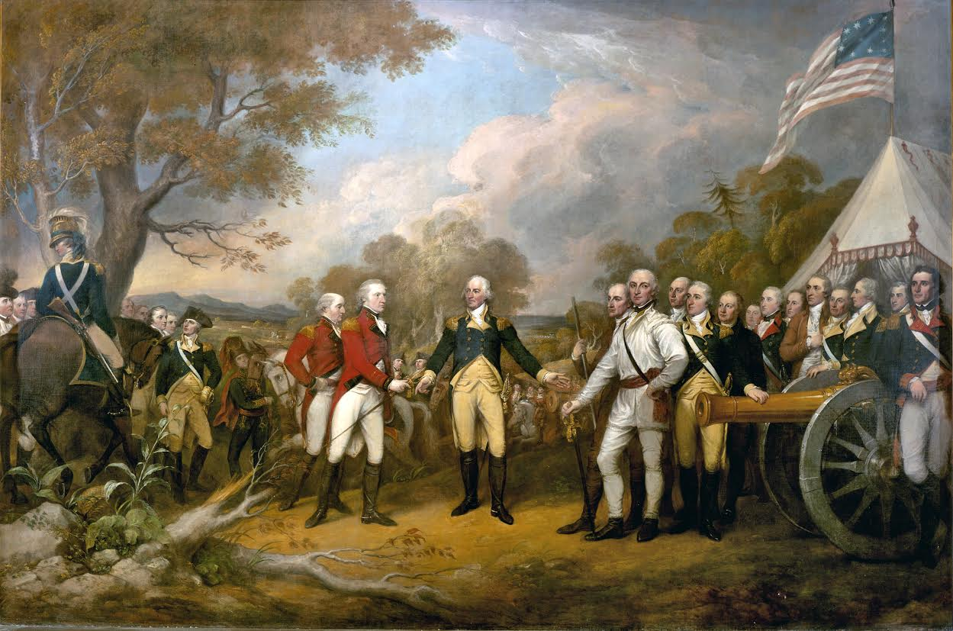
Battle of Saratoga 1777
Gates
Burgoyne
Colonial

Slide 19
Winter at Valley Forge 1777
Takes months for French aid to arrive
British troops stayed comfortably in Philadelphia for winter
Continental Army stuck in bitter winter conditions at Valley Forge, PA.
Frost bite, Disease..
2,000 out of 10,000 troops died.
Washington given credit as a leader for keeping his troops together, motivated, and alive (most of them).

Slide 20
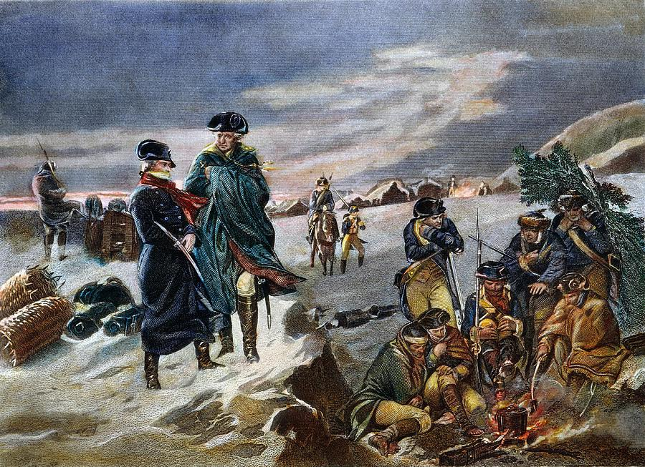
Valley Forge 1777
Washington
Von Steuban
Colonial

Slide 21
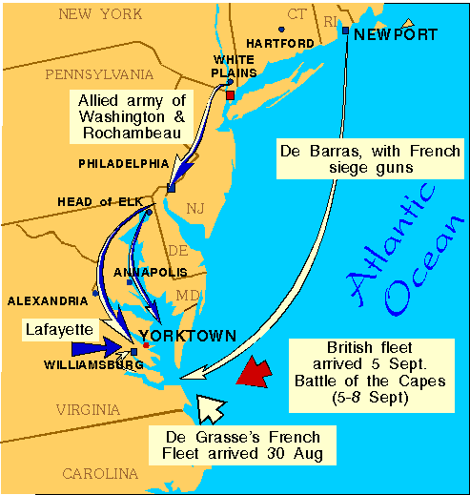
Victory at Yorktown
Lafayette suggested American and French forces join together and attack British forces at Yorktown. Americans would use the geography to their advantage.
Siege of Yorktown lasted 3 weeks
October 17, 1781 British General
Cornwallis, who was outnumbered and
under constant shelling, surrendered.
October 19, Washington accepted the
British surrender ending the Revolution

Slide 22
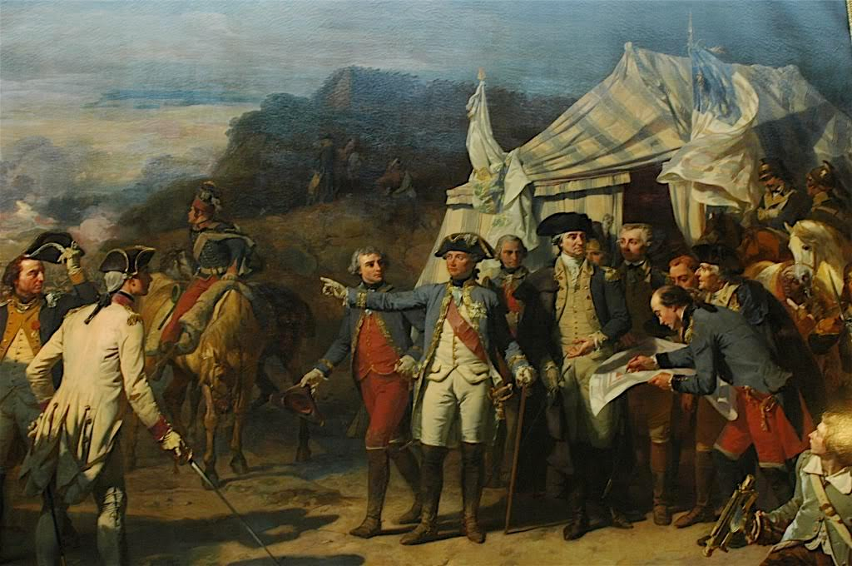
Battle of Yorktown 1781
Colonial
Washington
Lafayette

Slide 23
The Treaty of Paris 1783
Between Americans and British
Confirmed US independence
US granted land from Canada to Florida and from the Atlantic Ocean to the Mississippi River.
British removed all troops and forts from US land.
US agreed loyalists could sue for recovery of their losses.
US agreed British creditors could collect debts owed them by Americans.

